Slide 1
Discussion of Knowledge is Power: A Field Experiment in the Chinese and US Stock Markets
By Sonia Man-Lai Wong, Yuan Xue, Bohui Zhang, Xiaofeng Zhao
@CFRC 2022
Discussant: “J” Jiacui Li
David Eccles, U of Utah

Slide 2
What does this paper do?
Does: randomized experiment to educate investors on accruals
Finds:
Treated stocks experiences less accrual mispricing upon earnings releases
Treated firms have lower accruals going forward (interpreted as discipline)

Slide 3
Overall
Great idea
Doing controlled experiments in asset markets is GREAT
I hope to see more papers like this
Main comment: I am puzzled by the size of the effects
I hope the authors can provide more evidence of the channels

Slide 4
1. Let’s think through the effects

Slide 5
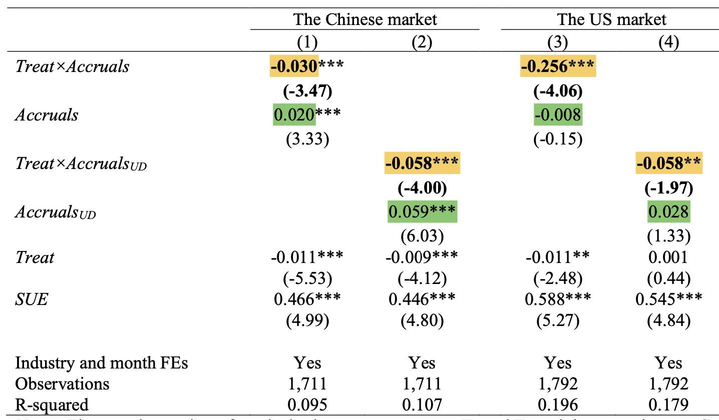
What is the effect found?
Control: prices somewhat respond to Accruals
Treatment: effect entirely reversed
Effect even stronger in the U.S.

Slide 6
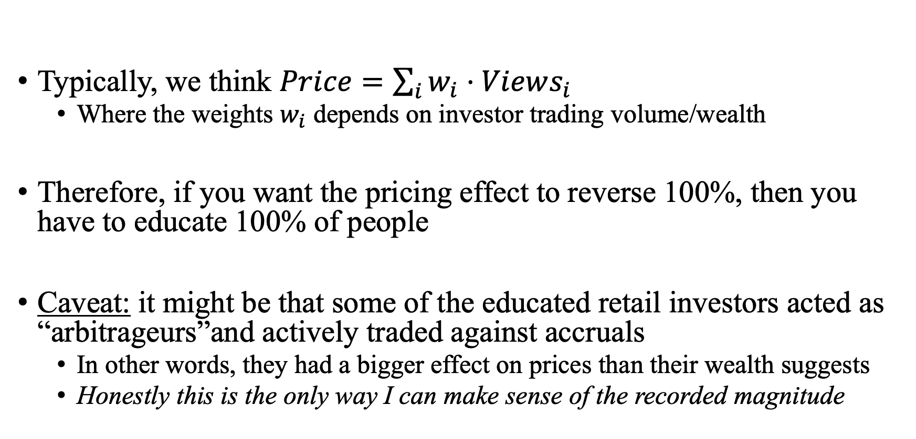
What does it take to produce such an effect?
Typically, we think $Price=\sum_{i}{w_{i}⋅Views_{i}}$
Where the weights $w_{i}$ depends on investor trading volume/wealth
Therefore, if you want the pricing effect to reverse 100%, then you have to educate 100% of people
Caveat: it might be that some of the educated retail investors acted as “arbitrageurs”and actively traded against accruals
In other words, they had a bigger effect on prices than their wealth suggests
Honestly this is the only way I can make sense of the recorded magnitude

Slide 7
1) What fraction of investors are reached?
How many retail investors are there in China?
Jones et al (2022): around 50 million accounts from *one* exchange
Other sources: 177 million total

Slide 8
2) Do they get it?
I looked into the educational material.
It is not easy to understand… I can’t imagine my grandma understanding this.

Slide 9
3) Does this impact firm behavior?
The paper finds that treated firms reduce their discretionary accruals after the experiment.
I really have trouble believing this… to the extent it made me think that this is what caused the pricing result.
E.g. For chance reasons, the treatment group had less accruals after treatment so there is nothing for prices to respond to

Slide 10
2. What can the authors do?

Slide 11
Verify that the treatment REALLY changes behavior
Give some retail investors/volunteers your educational message.
A couple of days later, ask them:
1) Do you understand it? (Let them repeat it to you)
2) How would you trade on this information?
If you really want to push the “change firm reporting” effect, I hope to see one company execute say it:
“I noticed that markets do not like accruals so we stopped doing it…”
The mechanism requires conscious recognition by firm executives

Slide 12
Summary
You can see that I am conflicted.
I really like what the paper does, and I really want to believe the results.
I might be massively underestimating the cognitive ability/power of retail investors, which the authors can prove me wrong.
I enjoyed reading the paper and hope to see it published well.

