Slide 1
Discussion of Dividend Momentum and Stock Return Predictability: A Bayesian Approach
By Juan Antolin-Diaz, Ivan Petrella, and Juan F. Rubio-Ramirez
@WFA 2022
Discussant: “J” Jiacui Li

Slide 2
Outline
1) How this paper fits into the literature
2) My understanding/assessment of the contributions
Caveat: I’m a low-tech person

Slide 3
1. Putting this paper into context

Slide 4
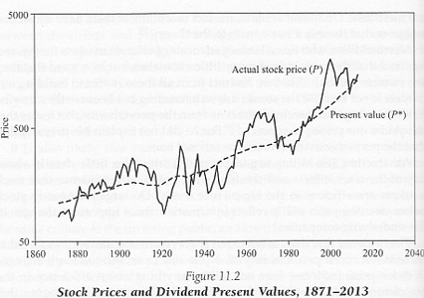
Background
“Excess volatility” puzzle
Shiller (1981): stock prices are too volatile
Campbell-Shiller (CS, 1988) provided a formal decomposition of returns into cash flows and “discount rates” (aka non-cash flows)

Slide 5
This paper proposes improvements to the standard VAR(1)-based Campbell-Shiller (CS) exercise
Two main findings in CS exercise:
1) “Discount rate” variation is a large fraction of aggregate stock price fluctuations
2) Returns are predictable using price/dividend ratios
This paper:
1) Corrects a common mistake
In VAR(1), we do NOT have to drop the dividend equation
2) Imposes a “skeptical prior” in a Bayesian approach
Even with skeptical priors, returns still appear predictable (weaker)
Technically very accomplished!
e.g. restrict the prior to satisfy CS accounting identity (importance sampling)

Slide 6
As a low-tech person, my assessments:
Contribution 1 (correcting mistake): clearly correct
People should change their current practice!
Contribution 2 (Bayesian estimation): this seems more like a general methodological contribution
This might be useful elsewhere (as the paper suggests)
The two contributions appear orthogonal to each other

Slide 7
2. What is the mistake being corrected?

Slide 8
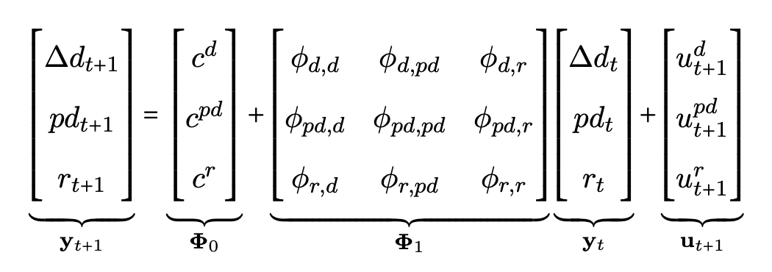
Existing work dropped a non-redundant equation
Full VAR(1):
Traditionally, people drop the first equation due to perceived collinearity from the CS identity:
This paper: there is still the $pd_{t}$ term! Thus not colinear

Slide 9
Paper shows this makes a difference
There is “dividend momentum”: $Δd_{t}↑ →$ $Δd_{t+1}↑$ AND $r_{t+1}↑$
… consistent with “prices not fully reflecting dividend persistence”
How much does this change the CS headline results?

Slide 10
Let’s be clear about what the mistake is
Not adding $Δd_{t}$ as a state variable, per se, is not a cardinal mistake
The CS approach does not specify the state variables $y_{t}$
CS’s approach quantifies $Discount Rate=Var(\sum_{j≥0}{ρ^{j−1}⋅E (r_{t+j}|y_{t})})$ and calls the residual “cash flow”
Thus, it is always good to add return-predicting variables (e.g. $Δd_{t}$)!
Campbell himself added a few later: interest rate, volatility…
Not adding $Δd_{t}$ because we assume it is redundant is a mistake

Slide 11
3. Bayesian VAR

Slide 12
My personal view on this
As researchers, I think many have accepted the main CS findings about (ex-post) return predictability and excess volatility
The Bayesian analysis tries to do a better job learning from the aggregate time series
In addition to the aggregate data, we also learn from “soft” sources:
Behavior of market participants
Institutional constraints/frictions
How elasticity is the market to demand movements
This is even more true for investors than researchers

Slide 13
Summary
The paper improves the Campbell-Shiller exercise
1) Corrects a long-standing mistake – which we should all take heed of
2) Devises a Bayesian VAR approach
I think the (impressive) Bayesian approach might be generally useful elsewhere, but I’m not equipped to judge
I learned a lot from the paper and wish the authors best of luck

