Slide 1
Discussion of Neglected Peers in Merger Valuations
By Guo, Liu, and Tu
@Cavalcade 2022
Discussant: “J” Jiacui Li
David Eccles, U of Utah

Slide 2
What does this paper do?
1) Peer firms of M&A targets listed in investment bank (IB) “fairness opinions” outperform matched firms in subsequent returns
2) Market prices are slow to respond to this information
I fully believe 2). I’ll focus on 1) today.

Slide 3
My takeaway
Empirically: very nice finding and lots of robustness checks
The authors have gone through immense pain collecting novel data
Mechanism: still somewhat mysterious to me
Some channels are very intuitive, but they are not quantitatively large enough
Other channels are large but not intuitive (to me)

Slide 4
What is the mechanism?

Slide 5
What do we need to arrive at the result?
Firm value
Consider an IB choosing peers from this space of possible firms
To get the paper’s result, IB needs to choose the blue area:
Valuation is high
But still undervalued
All firms
Market price

Slide 6
1) What if IBs just want a high valuation?
If IBs only want to hype up the valuation to justify takeover premium…
Eaton-Guo-Liu-Officer (2021)
Then they will choose the red ones
On average, this should lead to choosing overvalued firms that would underperform
So this can’t be the story
Firm value
All firms
Market price

Slide 7
Suppose IBs know which firms are undervalued…
That’s plausible.
But it is not clear why they would use that information.
They are not asked to put together a “market-beating portfolio”!
They are just providing fairness opinions
Firm value
All firms
7
Market price

Slide 8
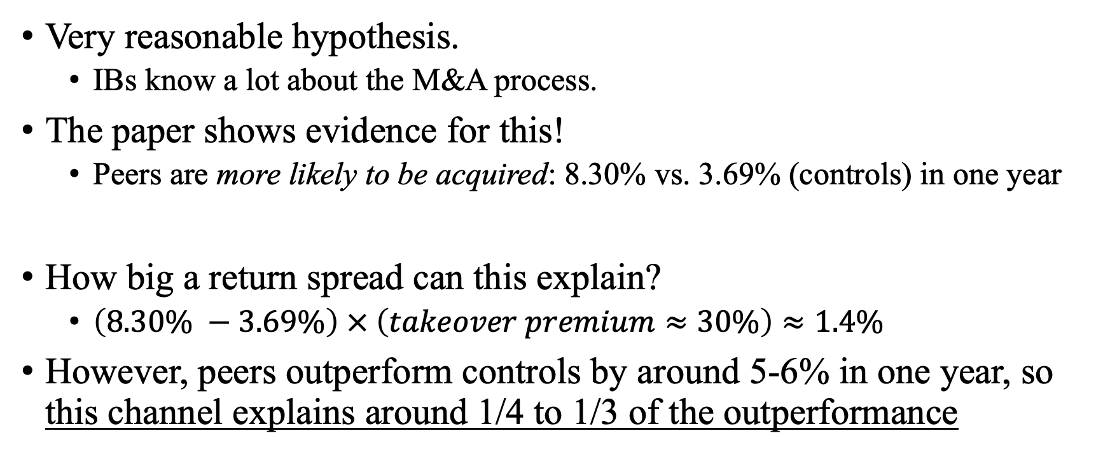
2) What if IBs are good at identifying takeover targets?
Very reasonable hypothesis.
IBs know a lot about the M&A process.
The paper shows evidence for this!
Peers are more likely to be acquired: 8.30% vs. 3.69% (controls) in one year
How big a return spread can this explain?
$\left(8.30\% −3.69\%\right) × \left(takeover premium≈30\%\right)≈1.4\%$
However, peers outperform controls by around 5-6% in one year, so this channel explains around 1/4 to 1/3 of the outperformance

Slide 9
3) Takeover-induced demand effects
When the target firm is acquired, its original investors need to reinvest their money somewhere.
They may just reinvest into peers!
Recent work shows that prices are inelastic, so this would push up peer prices
Paper shows results consistent with this!
Peers experience 1.1% increase in institutional ownership relative to controls
Standard estimates of price elasticity to demand is $M≈1−2$
So this can justify $1.1 −2.2\%$ additional annual return

Slide 10
However, the evidence is more complex
The takeover-induced demand effect is a one-time change
Paper also shows that the peer firms also attract more analyst coverage later, etc, so they really just seem like “better firms”

Slide 11
To sum up the calculations
What explains the 5-6% outperformance of IB chosen peers?
1) IB picking undervalued firms (despite higher valuation)
2) IBs know which ones will be acquired next
3) Takeover-induced demand effects
2) has strongest evidence, can explain 1/4 to 1/3 of the effect
3) has weaker evidence, can explain 1/3 – 1/2 of the effect
If we have to go to 1), it is still not clear to me why IBs would do so (even if they have superior information about firm value)

Slide 12
It is entirely okay if we can’t 100% pin down the mechanism…
Controls
Peers
… if so, then perhaps the authors can show (even further) that the results are not sensitive to the controls
Specifically: the current set of control firms are matched on N characteristics
What is the sampling distribution if you randomly leave one or two out?
Return
Main result of the paper

Slide 13
Summary
Very interesting paper, nice results
I would suggest the authors try to further pin down the mechanism, or show extra robustness for the empirical finding
I enjoy reading the paper and learned a lot in the process
Returning back to sanity, I recommend the authors ignore what I said and focus on converting the paper in the publication process

