Slide 1
Discussion of Informed Trading Intensity
By Bogousslavsky, Fos, and Muravyev
@Cavalcade 2022
Discussant: “J” Jiacui Li
David Eccles, U of Utah

Slide 2
What does this paper do?
Builds a machine learning algorithm to detect informed trading (IT)
Trained on “ground truth” events: 13D/insider trading/short selling
Paper shows that $\hat{IT}$ outperforms existing measures
And then applies $\hat{IT}$ to event studies and understanding asset prices

Slide 3
How is the algorithm trained?
Consider Elon Musk’s 13D filing on Twitter.
Train an algorithm: $Y_{i,t}=f(X_{i,t},θ)$
where $Y_{i,t}∈\left\{0,1\right\}$, $X_{i,t}$ includes many price/microstructure variables
13D filing

Slide 4
Overall
Good idea!
Also solid empirical execution. Results are sensible and interpretable
My comments will focus on:
Conceptual interpretation
How well do we expect the algorithm to work out of sample

Slide 5
Comments

Slide 6
1. What is informed trading?
Narrow definition: informed about cash flows
Expansive definition: informed about future prices
We use to think they are the same definition…
… because we assume that trades unrelated to cash flows have no price impact
Recent evidence does not support this view
See Koijen-Gabaix (2022) for a review
Informed about future prices,
possibly via knowledge
of own demand
Informed about cash flows

Slide 7
What are this and previous papers measuring?
Order flow imbalances DO create somewhat persistent price impact
However, most imbalances are not cash flow-relevant (e.g. Li and Lin (2022))
Recent papers show that “standard measures of IT don’t work”
E.g. Collin-Dufresne and Fos (2015), Ahern (2020), this paper
Perhaps they are measuring different types of IT?
One interpretation: this paper is creating a measure exclusively for the more restrictive definition of “cash flow IT”
Informed about future prices,
possibly via knowledge
of own demand
Informed about cash flows

Slide 8
2. How well would the algorithm capture other types of IT?
Even with the narrower definition, there are certainly more types of IT beyond the 3 types considered (13D/insider trading/short selling)
How well should we expect the algorithm to work for those types?

Slide 9
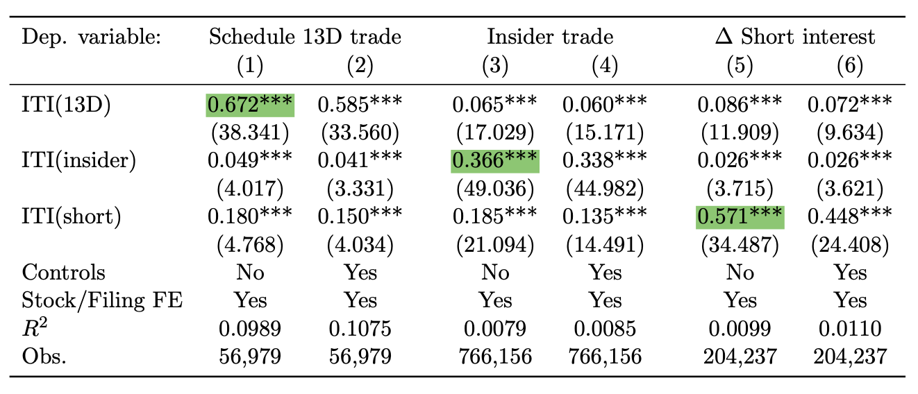
There is cross-detectability…
… that said, the main detectability is still within the same type
This might reflect fundamental differences between the IT types

Slide 10
3. Interpreting the R2 measures
Paper shows that $\hat{IT_{13D}}$ explains $IT_{13D}$ with $R^{2}≈10\%$
What is the sample selection?
There are two steps in predicting $IT$:
1) Is this day part of a 13D period?
2) If so, did IT happen?
The R2 in the paper applies to the second step
Non-13D days
13D days, red = IT happened
Non-13D days

Slide 11
Summary
Conceptual: I suspect this paper creates a measure of “cash flow-IT”
This is a subset of expansive definition of IT (informed trading)
Empirical:
There will be challenges when applying the algorithm out of sample
The fair comparison is not $100\% R^{2}$, but existing measures which don’t work at all… at least not in detecting cash flow-IT
I enjoyed reading the paper and look forward to the next version!

