Slide 1
Discussion of Institutional Synergies and the Fragility of Loan Funds
By Mustafa Emin, Christopher James, Tao Li, and Jing Lu
@UT Dallas 2023
Discussant: “J” Jiacui Li

Slide 2
Loans
CLOs
End investors
Trading
Funding
Mutual funds
Others
“Demand-based
asset pricing”
“Intermediary
frictions”
This paper: price pressure of mutual fund fire sales are smaller in “eligible loans” because they help CLOs pass overcollateralization (OC) tests

Slide 3
My two cents
Assessment: this paper shows that funding frictions can shape demand (and thus prices) in a new market
Lots of careful analysis
My discussion will first put a bit more structure on the problem and then use it to find areas for improvement

Slide 4
1. The mechanism

Slide 5
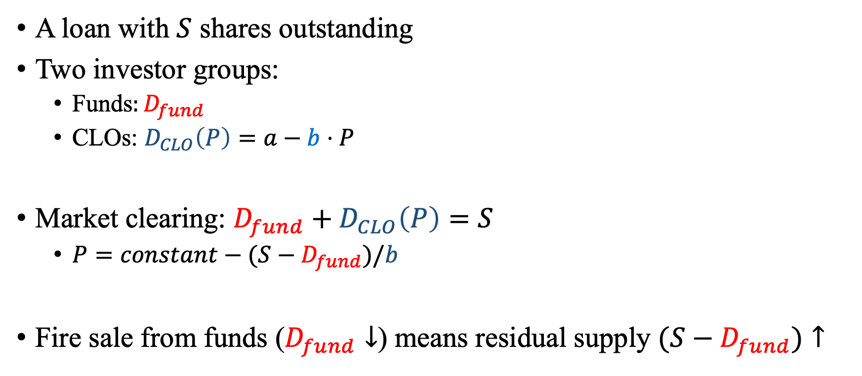
CLO demand elasticity determines the price impact of fire sales
A loan with $S$ shares outstanding
Two investor groups:
Funds$:D_{fund}$
CLOs: $D_{CLO}\left(P\right)=a−b⋅P$
Market clearing: $D_{fund}+D_{CLO}\left(P\right)=S$
$P=constant−(S−D_{fund})/b$
Fire sale from funds ($D_{fund}↓$) means residual supply $(S−D_{fund})↑$
$$S−D_{fund}$$
$$P$$
$$P_{before}$$
$$P_{after}$$
$$D_{CLO}\left(P\right)$$
$$Q$$

Slide 6
CLO demand elasticity depends on loan eligibility
CLO portfolio choice:
$$\max_{\{D_{1},…,D_{N}\}} \sum_{i}{D_{i}⋅\left(V_{i}−P_{i}\right)−risk_{i}⋅\frac{D_{i}^{2}}{2}}$$
$$s.t. \sum_{i}{D_{i}⋅\left(I_{i eligible}×Par_{i}+I_{i ineligible}×P_{i}\right)>OC test threshold}$$
Thus, CLO demand for each loan $i$:
$$D_{CLO,i}\left(P\right)=a_{i}−\frac{1+I_{i ineligible} ×Λ}{risk_{i}}⋅P_{i}$$
Where $Λ$ is the shadow price of the constraint

Slide 7
2. Okay, let’s revisit this paper

Slide 8
1) Some immediate predictions
Heterogeneity: the effect should primarily come from CLOs with binding OC constraints (around 40%).
Calibration: put in some numbers. Does this justify the magnitude of the estimated difference in fire sale price impacts?
… (and many more)

Slide 9
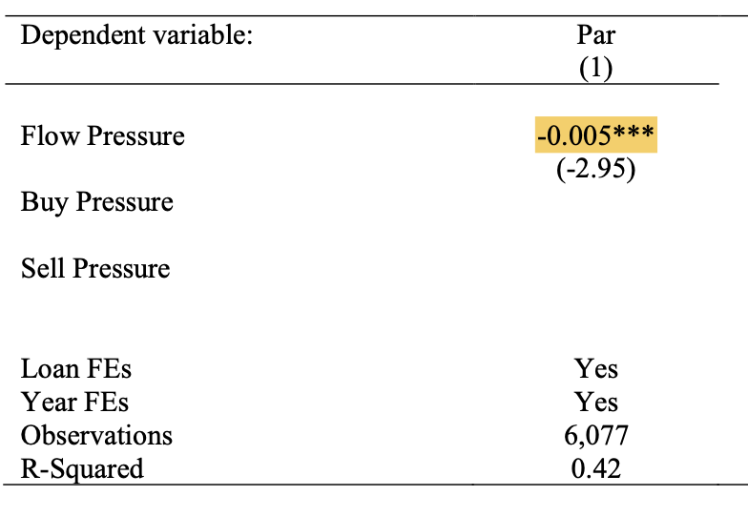
2) More interpretable exercises
For instance, Table 5 shows that CLOs do provide liquidity to mutual funds, but the coefficient is hard to interpret
Put them on the same units, and then we can ask what fraction of liquidity is provided by CLOs?
Given market clearing, it is not surprising that CLOs do provide liquidity
Magnitudes matter

Slide 10
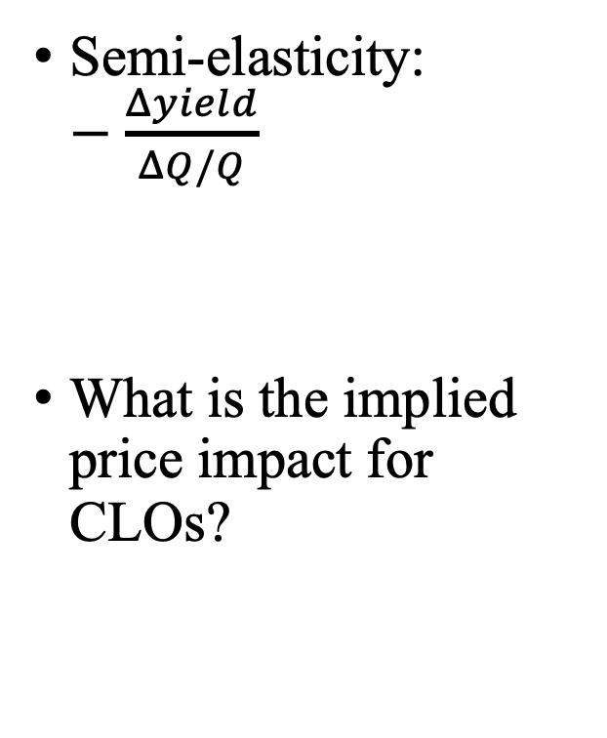
3) What is the price impact per unit of demand?
Semi-elasticity: $−\frac{Δyield}{ΔQ/Q}$
What is the implied price impact for CLOs?

Slide 11
4) The method for computing fund flow-induced fire sales
Existing evidence, in both the stock and corporate bond markets, suggest that Lou (2012) is a more appropriate approach than Coval-Stafford (2007)
E.g. Wardlaw (2020)

Slide 12
3. More broadly, for the literature

Slide 13
In studying demand/supply effects, I hope/think we are moving from 1.0 to 2.0
Version 1.0: showing that demand effects exist
Useful when the null hypothesis is zero demand effects
Version 1.5: probe mechanisms in a purely reduced-form fashion
This paper
Version 2.0: more structure, careful about magnitudes
Not necessarily Koijen-Yogo!

Slide 14
In summary
My (idiosyncratic) discussion reflects my personal bias for conducting version 2.0 studies
I learned a lot reading this paper
I wish the authors all the best in the publication process

