Slide 1
Discussion of What Do the Portfolios of Individual Investors Reveal About the Cross-Section of Equity Returns?
By Sebastien Betermier, Laurent E. Calvet, Samuli Knüpfer, and Jens Kvaerner
@CFE 2021
Discussant: “J” Jiacui Li

Slide 2
Overview
Using administrative data on Norwegian household stock holdings:
Holdings: investor stock selection systematically differs by age and wealth
Pricing: age- and wealth-sorted portfolios have large return spreads and (partially) spans FF5 + momentum factors
Interpretation: 1) life-cycle based hedging + 2) sophistication
Overall assessment:
Remarkable empirical work with clear contribution to the literature
My comments will be about 1) interpretation and 2) magnitudes

Slide 3
Marginal contribution to the literature
Existing papers connecting heterogeneous holdings to asset pricing
Koijen Yogo (JPE 2019): holdings $↔$ Variation in ${Price}_{t}$
Balasubramaniam et al (JF forthcoming): factor structure in holdings
This paper: holdings $↔$ cross-sectional $E({Ret}_{t})$

Slide 4
1. Key results in the paper

Slide 5
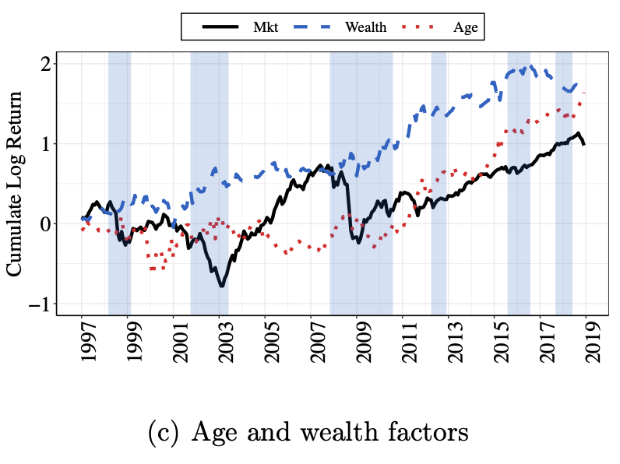
Key findings in the paper
Long/short 30%/30% factors:
$Factor^{Age}=Ret^{mature}−Ret^{young}$
$Factor^{Wealth}=Ret^{rich}−Ret^{poor}$
Both have annual CAPM alphas of $≈$12%
Market + these two factors (partially) span FF5 + momentum in Norway

Slide 6
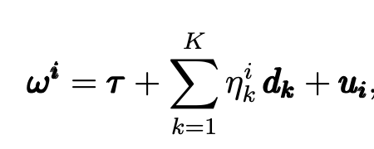
What is the interpretation?
Suppose investors hold the tangency portfolio ($τ$) + loadings on a few zero-investment “deviation portfolios” ($d_{k}$)
Then, market factor + the deviation portfolios will explain expected returns
Well, what are people hedging?
For the “age factor”, could be hedging labor income risk (ICAPM)
For the “wealth factor”, perhaps can be related to sophistication/sentiment
The paper shows some evidence for both mechanisms

Slide 7
2. Comments

Slide 8
1) How much can hedging plausibly explain?
We are talking about 12% annual return spread
Not even long/short decile portfolios. Long/short 30% portfolios!
This kind of magnitude is difficult to rationalize in structural models with reasonable parameters on preferences and risks
Conflict of interest: related to something I’m working on
To be clear, the paper does not say this is all due to hedging
If you really think labor hedging is important, there are more direct tests to run
Specifically, how correlated is the age factor with income risk?
E.g. like in Santos Veronesi (RFS 2006)
Also, try to do a composition on hedging vs. sentiment proxies (Tables 4-5)?

Slide 9
If you don’t believe models, do a “gut check” to think about this magnitude
Suppose you are a personal financial advisor facing a young client.
Imagine how well this conversation will go:
Client: “What should I invest in?”
You: “I recommend you buy this 2050 target date fund”.
Client: “Why is this a good investment?”
You: “This fund helps hedge your labor income risk. It will underperform other funds by 12% a year. Hey! It is totally worth it.”
I predict that this will be your last conversation with this client.

Slide 10
There is an unfortunate conflict…
… between theoretically realistic hedging-based premium and empirically publishable cross-sectional return predictors
Empirically publishable threshold: t-stat > 2 (some say 3)
This paper, with 21 years of data, finds t-stats around 2.5
For inferring expected returns ($N^{1/2}$ convergence rate), even using 1963 – 2021 sample (58 years) require roughly 6-7% annual return for t-stat > 2
Conclusion: if a return predictor is publishable, it is difficult to be (fully) interpreted as hedging premium

Slide 11
2) Understanding the magnitudes
Suggestion: take demand-based price effects seriously
Clearly, young/poor households have higher demand for certain stocks
How much can their demand move prices?
How much expected return spread can this generate?
$Price^{actual}=Price^{frictionless}+M⋅ExcessDemand$
Everything being equal, higher excess demand $⇒$ higher price $⇒$ lower E(ret)
We have some idea about the price multiplier $M$
See Gabaix Koijen (2021) and all the references therein
Additional considerations
Household ownership is around 30% of stock market in Norway (OECD)

Slide 12
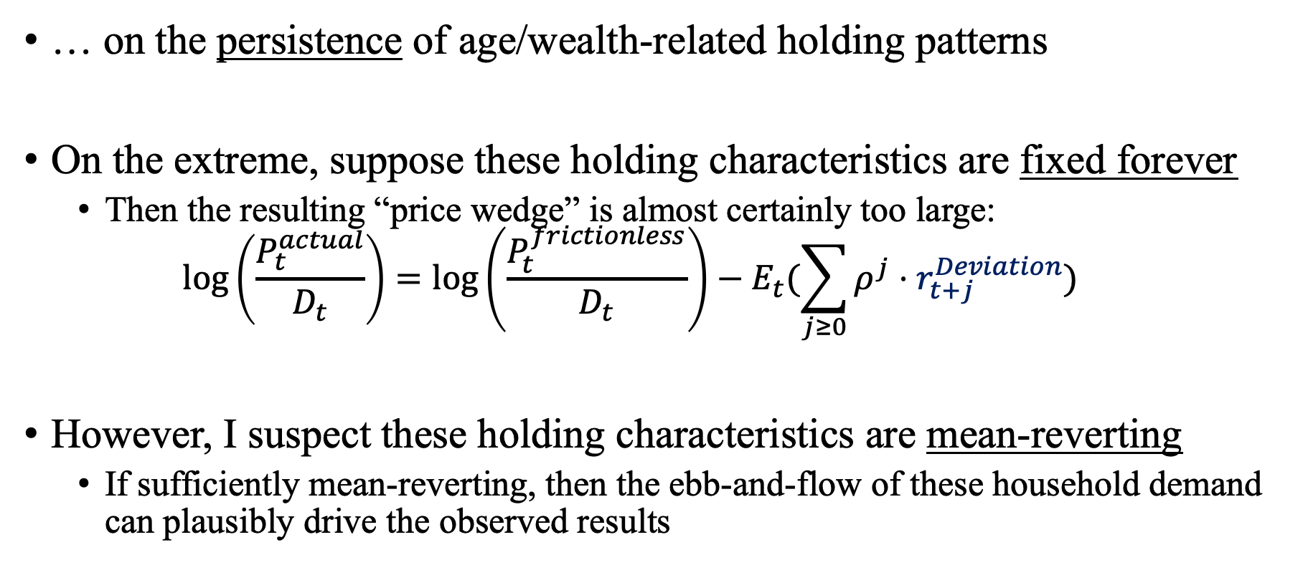
Whether the magnitudes can arise from demand-based price effects depends…
… on the persistence of age/wealth-related holding patterns
On the extreme, suppose these holding characteristics are fixed forever
Then the resulting “price wedge” is almost certainly too large:
$$\log\left(\frac{P_{t}^{actual}}{D_{t}}\right)={\log\left(\frac{P_{t}^{frictionless}}{D_{t}}\right)−E}_{t}(\sum_{j≥0}{ρ^{j}⋅r_{t+j}^{Deviation}})$$
However, I suspect these holding characteristics are mean-reverting
If sufficiently mean-reverting, then the ebb-and-flow of these household demand can plausibly drive the observed results

Slide 13
Summing up
This paper shows that correlated variation in Norwegian household stock holdings is related to the cross-section of expected returns
Great data + careful empirical work
I think more can be done on the mechanism/interpretation front
I really enjoyed reading the paper and wish the authors all the best

Slide 14
Appendix

Slide 15
OCED’s numbers on Norwegian direct household ownership
https://www.oecd.org/corporate/Owners-of-the-Worlds-Listed-Companies.pdf
According to an OECD report, the share of individual ownership in Norwegian stock market is at most 30%
In contrast, in U.S., institutional ownership is around 60% (Koijen Yogo)
They also “model” the entire non-institutional holding as a residual (of course less satisfying)
Table A.3 (as of 2017):
34% by government
8% by private corporation
7% by “strategic individuals”
Refer to physical persons that are either controlling owners or members of a controlling family or block-holders and family offices.
29% by institutional investors
21% by “Other free-float including retail investors”

