Slide 1
Discussion of What Drives Stock Prices in a Bubble?
By Weihua Chen, Shushu Liang, and Donghui Shi
@Cavalcade 2023
Discussant: “J” Jiacui Li

Slide 2
Paper summary
This paper marries two literatures:
1) Bubbles
2) Demand-system of asset pricing (Koijen Yogo, 2019)
Main finding:
Retail investors contributed substantially to the 2015 China stock bubble
Fits the Kindleberger (1978) narrative:
Bubble formation: good fundamental news
Expansion: increased speculation, especially from new entrants
Deflation: preferences changes (back to caring about value)

Slide 3
Outline of my discussion
First, some obvious points
Important research question
Rich trading data (retail + institutions)
Well-written paper. I learned a lot reading it
My discussion will focus on the demand-system
1) Mostly for the audience: what does it add beyond reduced-form evidence?
2) Mostly for the Shushu: how to possibly improve it?

Slide 4
1. What does a demand system add?

Slide 5
What does the demand-system do?
A model of the price effect of trading; allows for counterfactuals
Others have also studied the 2015 Chinese stock market bubble
They also really want to say that retail trading caused the bubble, but they can’t, so ended up saying something else
Bian et al (2021): margin-trading behavior
Liao, Peng, and Zhu (2022): trading volume
An, Lou, and Shi (2022): wealth transfer

Slide 6
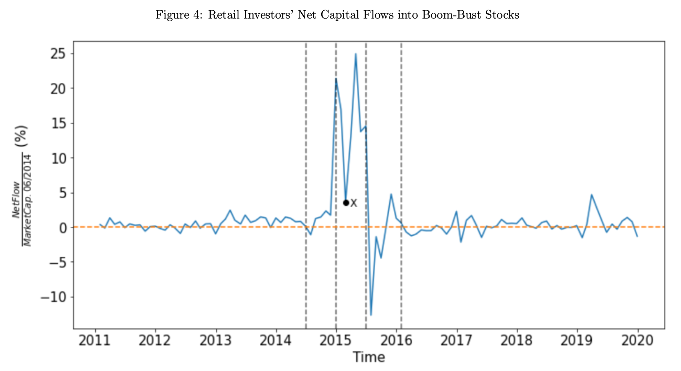
Retail investors massively bought stocks in the bubble expansion phase

Slide 7
Q. What is the price impact of such buying?
Possible answers:
1) “Zero. For every buyer there is a seller.”
2) Positive price impact if there is imperfect liquidity provision, but not sure how much.
3) Shushu: quantify using a demand-system.

Slide 8
Demand-system, caricature
$${S−a}_{R}$$
$$P$$
$$P_{new}$$
One asset with $S$ shares outstanding
Investors: $i∈\{$Retail, Institution$\}$
Demand functions:
$D_{R}\left(P\right)=a_{R}$
$D_{I}\left(P\right)=a_{I}−b_{I}⋅P$ ($b_{I}$ = demand elasticity)
Market clearing: $a_{R}+(a_{I}−b_{I}⋅P)=S$
$⇒P=\frac{a_{R}+a_{I}−S}{b_{I}}$
Takeaway: price impact of increasing retail demand ($a_{R}↑$) depends on demand elasticity of other investors ($b_{I}$)
$$P_{old}$$
$$D_{I}\left(P\right)$$
$$Q$$

Slide 9
How to you estimate demand elasticities?
You need instruments (demand shifters).
Koijen-Yogo uses BLP instruments
For each investor $i$, $\sum_{j≠i}{ExogenousDemand_{j}}$ is the price shifter
Koijen-Yogo assumes AUM- and investment universe-induced demand as exogenous
Shushu improves by focusing on a subset of “stable institutions”

Slide 10
How good are these instruments?
Relevance
IO-type instruments
Shushu
Koijen-Yogo
Index inclusion
Exogeneity

Slide 11
2. Questions/suggestions

Slide 12
Cross-section vs aggregate
This paper studies the “relative bubble” between “boom-bust stocks” and the others
“Boom-bust stocks” up by 400%; market up by 150%
In estimating price impact, can what extrapolate cross-sectional relationships to the aggregate?
Often done in corporate/household, but there are complications here.
My concerns are not about the core idea, and only about specification
But specification matters in a structural exercise

Slide 13
Two issues
1) Demand elasticities are different at different levels
Market < factor/style < stock-level
Li and Lin (2022), An, Su, and Wang (2022) , Chaudhary, Fu and Li (2023)
2) Spillovers between stocks
Buying “boom-bust stocks” will also push up the price of other stocks
This channel is shut-off in Koijen-Yogo
This is counterfactual. This shortcoming is also widely acknowledged
Fixes: nested logit (e.g. Fang (2023)), or modeling covariance (An (2023))

Slide 14
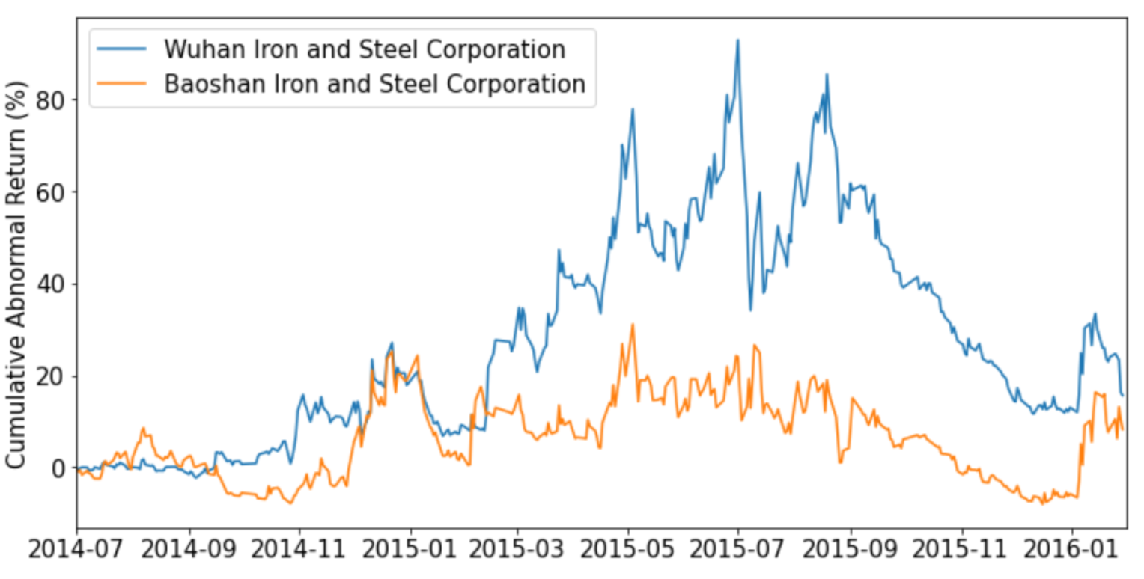
Just to reiterate the spillover point…
Sadly, asset pricing $≠$ corporate finance.

Slide 15
Other suggestions/questions
1) Vet the structural model using reduced-form evidence.
E.g. does your instrument predict returns?
2) What is special about a bubble?
Is demand elasticity constant? Should it change in a bubble?
3) You often only plot what happened to boom-bust stocks.
Also plot what happens to the other stocks, given the paper is explaining a cross-sectional bubble?

Slide 16
Summary
This paper uses a demand-system to study the driver of bubble and busts
A very nice paper
People can always have specification suggestions (like mine), but I am bullish on the general direction

