Slide 1
Discussion of “Valuation and Long-Term Growth Expectations”
By Angel Tengulov, Josef Zechner, and Jeffrey Zwiebel
@NFA 2020
Discussant: “J” Jiacui Li
David Eccles School of Business, Utah

Slide 2
Overview
Motivation: while long-term growth is a significant part of firm valuation, academic and practitioners are inattentive towards it
This paper:
Builds a machine learning model to predict long-term growth rates
Argues that long-term growth is mispriced in the market. Long/short decile portfolios based on predicted growth generates 10-13% alpha a year
This is an important topic and the paper is well executed
My discussion will focus on the mechanism and economic magnitudes

Slide 3
1. Findings in this paper

Slide 4
Predicting long-term growth rates
Which variables predict growth rates? The authors used LASSO:
Careful out-of-sample prediction exercise
Outcome variables: 5 or 10 year EBITDA/Sales growth rates
The resulting R2 is decently high: 15 – 28%

Slide 5
Trading on predicted long-term growth
Trading on this measure is profitable!
Long/short decile portfolios generates 10-13% annual return
Not subsumed by conventional characteristics in Fama-MacBeth regressions
Caveat: results weaker when value-weighted (Table A5, A6)

Slide 6
2. Discussion

Slide 7
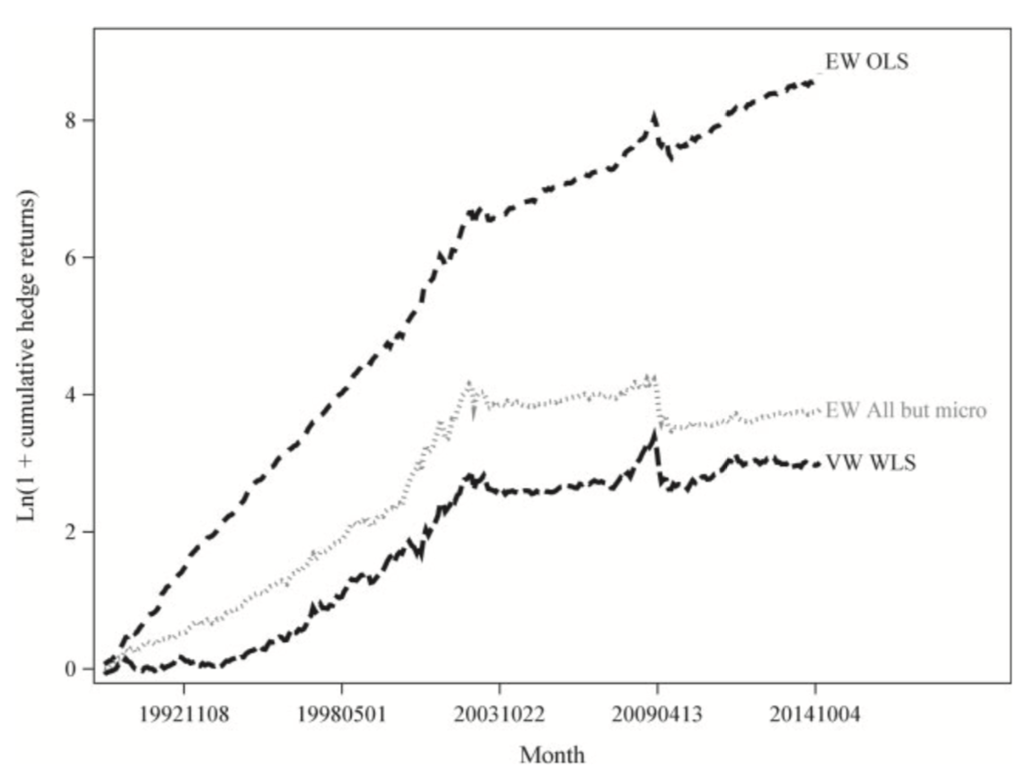
1. Economic magnitudes
How much money are investors leaving on the table?
It is well-known that anomalies are larger in small caps stocks
Green, Hand, and Zhang RFS (2017), Hou, Xue, and Zhang RFS (2020)
Fig 3 in Green, Hand, and Zhang RFS (2017)

Slide 8
Seeking larger economic magnitudes
Instead of using $\hat{Growth}$, perhaps can look at $\hat{Growth}−LTG$ (analyst predicted growth)?
La Porta (1996): firms with high analyst predicted LTG (long-term growth) have low subsequent returns
Bordalo et al JF (2019): results are concentrated in firms with very high LTG

Slide 9
2. Mechanism
There are really two separate questions.
1) Are investors inattentive to long-term growth?
Anecdotally: very much so
This paper presents further evidence
2) Do they lose much due to this?
If the return predictability is concentrated in small caps that are relatively illiquid, then we are not sure.

Slide 10
“Rational inattention”?
If investors have limited cognitive resources, they should allocate it based on expected payoff and cost
Cost is high: estimating long-term growth rate is difficult
Of course, as we have computers, LASSO (since 1996), and this paper (since 2019), the cost goes down over time
Payoff may not be high:
Because this is about long-term growth rates, it is likely slow for prices to converge
The paper does show that investors are leaving sizeable amount of money on the table for small cap firms.
A careful quantification exercise might still reveal irrationality of investors in these companies

Slide 11
3. Additional exercises?
Do long-horizon active investors appear to trade on this mispricing?
As discussed, such a strategy may be less attractive for short-horizoned arbitrageurs such as hedge funds
Can infer from 13F data. Key difficulty: need to first filter out passive ones
Omitted varaible problem: long-horizon investors also tend to be passive
The other economic consequences of long-term growth-neglect?
Does it drive corporate short-termism?

Slide 12
Summary
This paper is interesting and well executed
Investor inattention to long-term growth rate is ex-ante plausible
The authors provide further evidence
Economic mechanism: perhaps more work can be done to differentiate between rational and irrational inattention

